Slide 1
Prelim Presentation
Aaron Dancer, Ernest Pallares, John Molina, Thanh Dang & Hieu Vy

Slide 2
Specifications
Defining the product

Slide 3
Base Specifications (Requirements)
5x5 grid, 4-in-a-row to win
Different colored stones representing each player
3 difficulties
PvP or PvC
First player picks who goes first
Player History
Registered player or play as guest
Notes:
Ernest

Slide 4
Consumer & Customer Interview
Customer Interview
Consumer Interview
Q: Does 5x5x4 mean 2D or 3D? A: The grid is 2D (5x5), 4-in-a-row to win
Q: Is history defined as play-by-play or user score? A: User score
Q: How many difficulty levels do there need to be? A: 3
Q: Should there be an undo option? A: Yes
Q: What platforms do you want to play the game on? A: Mobile and Computer
Q: Can I delete my registration information A: Yes
Q: Can I change my background? A: Sure
Q: Can it be played offline? A: Yes
Notes:
Wayne

Slide 5
Revised Specifications
Base Specifications
Additional Specifications
5x5 grid, 4-in-a-row to win
Different colored stones representing each player
3 difficulties
PvP or PvC
First player picks who goes first
Player History
Registered player or play as guest
Undo button
Playable on computers (Windows, OS X) and mobile platforms (iOS, Android)
Ability to delete user registration information
UI Customization (background)
Notes:
Ernest

Slide 6
Project Management
Stepping Stones

Slide 7
Communication
Face-to-face meetings Tuesdays after 5:45pm
SMS
Email
Trello
Documents shared via OneDrive, Google Drive, and Trello
Notes:
Aaron

Slide 8
Software Development Plan
Unified Process
Trello for task management & scheduling
Git for version control
Notes:
John

Slide 9
Roles & Responsibilities
Aaron Dancer – Team Lead, Graphic Design, UI & UX
Ernest Pallares – SQA, Project Manager
John Molina – Software Secretary, Interpersonal Control
Thanh Dang – Programmer, Treasurer, CenterPoint
Hieu Vy - Programmer
Notes:
John

Slide 10
Risk Management Plan
2-person fallback for roles and responsibilities
Redundant file storage, local & online
Inspections, Walkthroughs, Checks and Balances
Notes:
Hieu

Slide 11
Design & UX
Beautiful and Simple

Slide 12

The Obvious
Growth
Simplicity
Notes:
Aaron

Slide 13
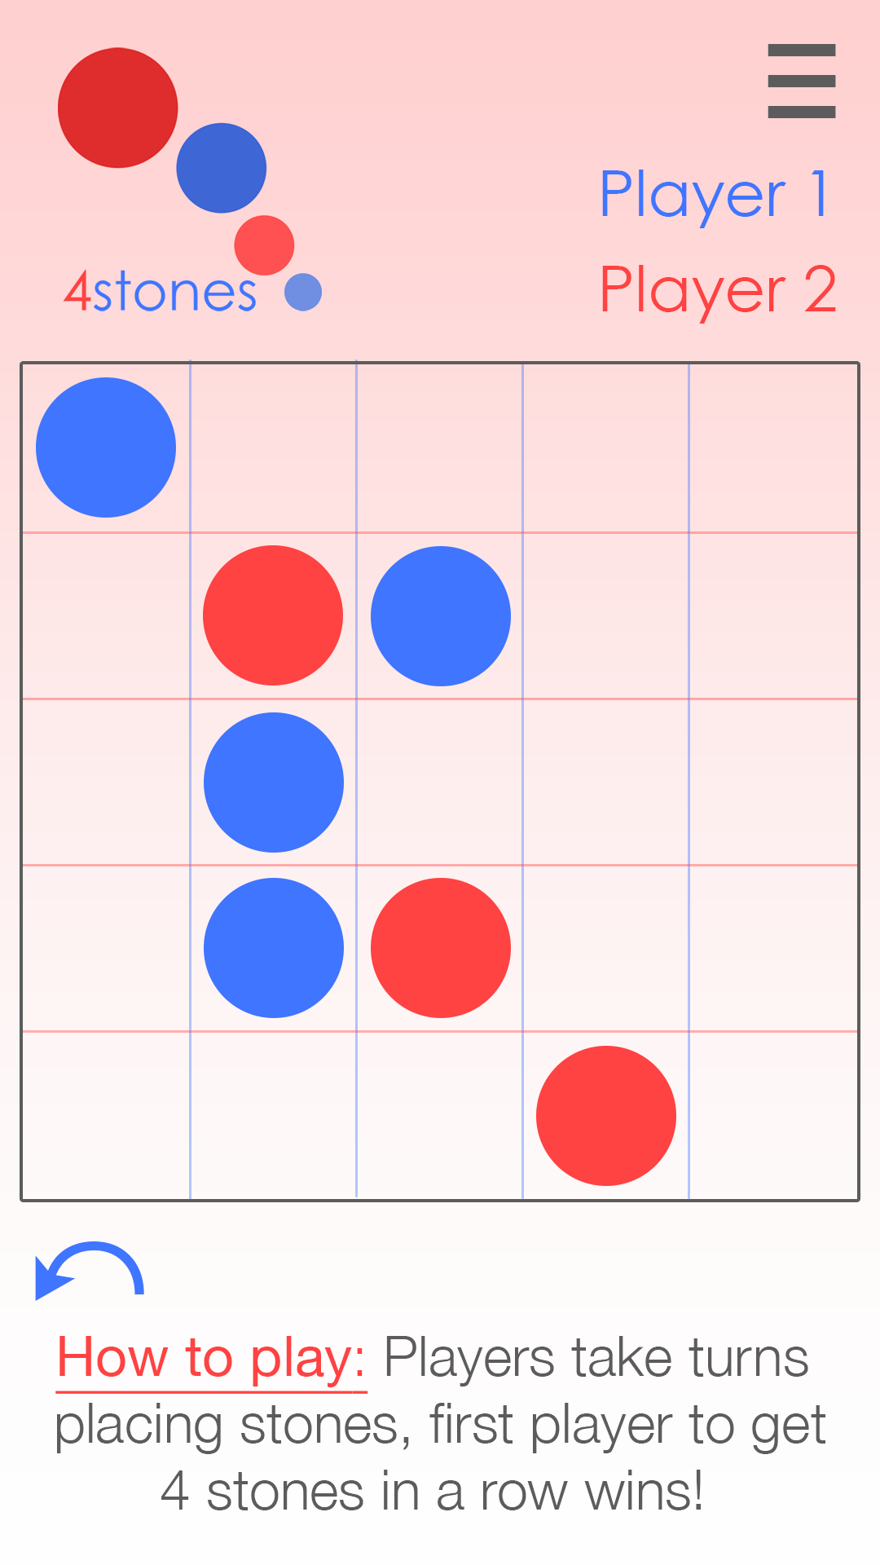
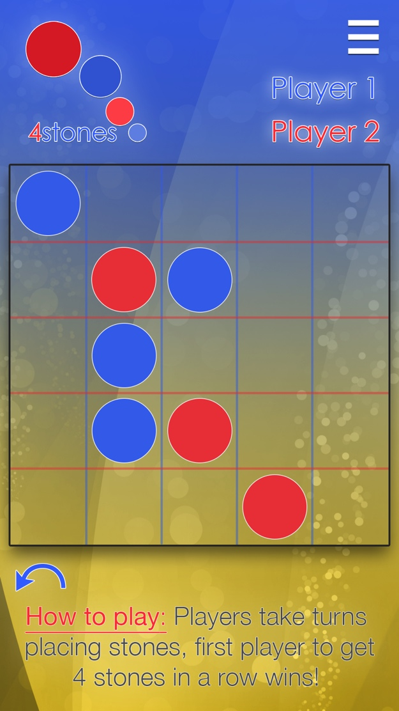
The UI & UX
Simple
Dynamic & Responsive – Fits all screens (within reason)
Customizable
Background highlights changes with player turn
Notes:
Aaron

Slide 14
Misc. Logistics
Whatever we didn’t say already

Slide 15
Deployment Plan
Google Play, Aptoide, Amazon for Android
App Store for iOS & OS X (Mac)
Website for Windows & OS X
Notes:
Hieu

Slide 16
Planned Release Dates
Beta: November 4, 2014
RTM: December 4, 2014
Notes:
Wayne

